Slide 1
SQE1 - how the first assessment went

Slide 2
Julie Brannan,
Director of Education and Training, SRA

Slide 3
SQE1 – November 2021
1,090 candidates, including 27 solicitor apprentices, took part in 100+ centres around the world
Two parts: Functioning Legal Knowledge 1 and Functioning Legal Knowledge 2
Candidates need to pass both parts, to pass SQE1

Slide 4
SQE1 – pass mark and rate
FLK1 was 57%
FLK2 was 56%
53% of candidates passed both assessments
67% passing FLK1
54% passing FLK2

Slide 5
Diversity
No material difference in performance by gender, disability, or social mobility
Was troubling attainment gap by ethnicity
60% of candidates did not fully complete EDI questionnaire

Slide 6
Diversity
Data is from a single sitting and represents c.10% of anticipated future annual cohort numbers
No evidence of bias in the assessment
Research commissioned from University of Exeter into causes of attainment gap in professional legal education

Slide 7
Operational matters
Candidate handling at Pearson Vue test centres
Results delayed from 15.00 – 21.00 on 20 January
Introduction of queueing system for SQE2 booking

Slide 8
Pass rates by provider
We will be publishing pass rates by provider by end 2023
We have not done so now, because results of a single assessment with relatively small overall cohort may not be representative
We have fed back to those providers with largest candidate numbers in private so they can evaluate their training

Slide 9
SQE1 – conclusions and next steps
‘The initial SQE1 exam appears to have successfully delivered valid fair, reliable and defensible outcomes. Each of the stages of preparation; delivery and processing outcomes for the exam demonstrated significant evidence of good practice.’
Geoff Coombe – SQE Independent Reviewer

Slide 10
Geoff Coombe, SQE Independent Reviewer

Slide 11
Role of independent reviewer
Provide external assurance to SRA and Kaplan that the SQE will deliver outcomes that are fair, defensible and command public confidence

Slide 12
Reviewing the first SQE1 assessments
Observed training meetings for new question writers
Reviewed processes and training materials for all preparatory processes
Interviewed Kaplan and SRA staff before and after the exam
Observed candidates sitting the exam at a test centre
Reviewed summary management information

Slide 13
High level conclusions
Each of the stages of preparation, delivery and processing outcomes for the exam demonstrated significant evidence of good practice
Evidence of a robust lessons learned process, mainly minor but important, improvements needed for future sittings

Slide 14
High level conclusions
Process for determining the pass boundaries was well considered and effective
From a technical perspective the SQE1 assessments appear to deliver an effective assessment

Slide 15
High level conclusions
Differences in outcomes by demographic group - white candidates achieving higher pass rate than other ethnic groups
Does not mean the assessment was unfair - good safeguards in place to avoid unintended bias when setting questions and reviewing how the exam performed
Wealth of information about candidate performance now available, which enables further analyses

Slide 16
Zoe Robinson,
Director of Qualifications, Kaplan

Slide 17
Pass marks
Statistic | FLK1 | FLK2 | SQE1 overall
Candidate | 1084 | 1078 | 1073
Passing score | 57% | 56% | -
Pass rate | 67% | 54% | 53%
Statistic | FLK1 | FLK2
Mean % | 61.2 | 56.8
Std. Dev % | 12.6 | 13.9
Median % | 62 | 58
Min % | 21 | 22
Max % | 89 | 89
Range % | 68 | 67

Slide 18
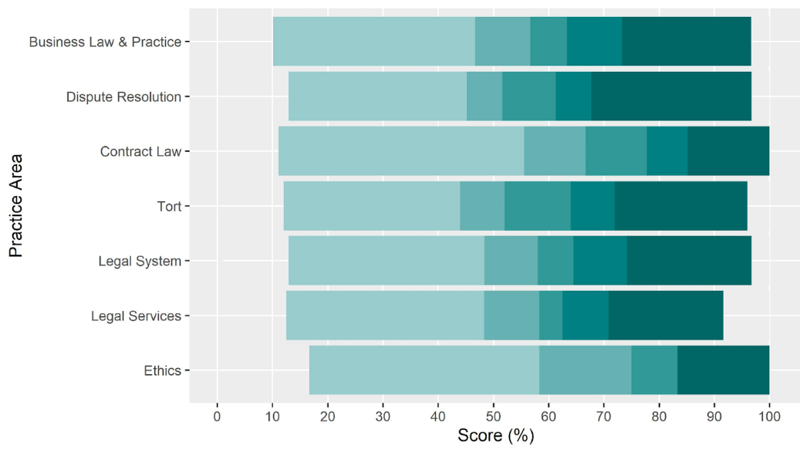
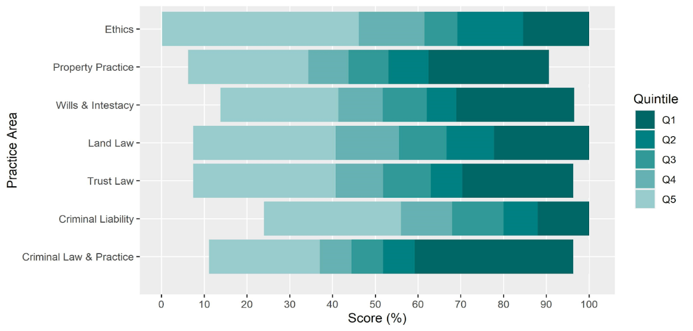

Practice areas
FLK1
FLK2

Slide 19
Future sittings
April 2022 SQE2
Written: 11-13 April
Oral: 19-29 April
Bookings open between 31 January - 7 March
Results out towards the end of August

Slide 20
Future sittings
July 2022 SQE1
Bookings open between 17 March - 16 June
FLK1 on 21 July and FLK2 on 25 July
October 2022 SQE2
Oral: From week commencing 24 October
Written: 7-9 November

Slide 21




Keep in touch
Send your queries to contactcentre@sra.org.uk
Join our SQE LinkedIn group
SQE assessment sqe.sra.org.uk / SQE route sra.org.uk/sqe
SQE Update bulletin sra.org.uk/sqeupdate

