Slide 1
SQE2 - how the first assessment went

Slide 2
Julie Swan,
Director of Education and Training, SRA

Slide 3
Overview – SQE2 first sitting (April 2022)
Written assessments taken in 86 test centres across 24 countries – 12 written assessments (stations)
Oral assessments taken in 4 centres in England and Wales – 4 oral assessments (stations)
Oral assessments taken on 4 different days – 4 ‘runs’ - using different tasks with pass marks set for each run so that candidates on different days were not advantaged/disadvantaged

Slide 4
Overview – SQE2 first sitting April 2022
726 candidates received results on 25 August 2022
390 candidates will qualify under the transitional arrangements and so did not take SQE1 (LPC and QLTS MCT candidates)
All other candidates had to pass SQE1 before sitting SQE2
Indications that this first cohort was atypical
22 apprentices took the assessment

Slide 5
Outcomes
Overall pass rate 77% (53% pass rate for November 2021 SQE1)
Higher a candidate’s degree classification, the better they performed
  Higher a candidate’s SQE1 mark, the better they performed

Slide 6
Outcomes
  Those that had done some qualifying work experience performed better than those who told us they hadn’t
  Candidates performed better in advocacy, interview/attendance note and legal research tasks than in legal drafting, legal writing and case and matter analysis

Slide 7
Demographics
79% of females and 75% males passed
92% of candidates who told us they had a disability passed
Apprentices had a very high pass rate

Slide 8
Demographics
Overall pass rates varied by ethnicity:
  72% Asian/British Asian candidates
  53% Black/Black British candidates
  55% candidates who declared ‘other’
  76% candidates who preferred not to say
  92% mixed/multiple ethnic groups candidates
  85% white candidates
There is no evidence that the questions/tasks were biased

Slide 9
SQE1 – July results and next steps
July 2022 results published 5 October - 53% pass rate
Candidates affected by disruption at one centre
January 2023 booking window open until 19 December
Higher than expected demand for seats
Additional capacity arranged to accommodate candidates

Slide 10
Overview of SQE2 exams April 2022
Geoff Coombe, SQE Independent Reviewer

Slide 11
Role of independent reviewer
Provide external assurance to SRA and Kaplan that the SQE will deliver outcomes:
  Fair
  Defensible
  Command public confidence

Slide 12
Reviewing the SQE2 – gathering evidence
Observed training meetings for assessors
Reviewed plans and risk assessments for key processes
Interviewed Kaplan and SRA staff before and after
Observed candidates at different venues – both oral and written exams
Reviewed summary management information

Slide 13
High level conclusions
Each stage of the exam showed good practice and policies were adhered to, including:
  preparation
  delivery
  processing outcomes
SQE2 is operationally complex
The psychometric evidence shows the exams delivered well

Slide 14
High level conclusions
There is a thorough lessons learned process - minor but important improvements for future sittings
The process for determining the pass boundaries was carefully considered and effective
Prior educational attainment remains the most reliable predictor of SQE2 outcomes (as it did for SQE1)

Slide 15
High level conclusions
There were differences in outcomes by demographic group, including white candidates achieving a higher pass rate than other ethnic groups
This does not mean the assessment was unfair and good safeguards in place to avoid unintended bias, including:
  anonymised marking of written papers
  training for assessment writers and oral exam assessors

Slide 16
Zoe Robinson,
Director of Qualifications, Kaplan
Tracyann Tweedie,
Academic Head of SQE2, Kaplan

Slide 17
SQE2 marks
Sitting | Oral sitting 1 (19-20 April) | Oral sitting 2 (21-22 April) | Oral sitting 3 (26-27 April) | Oral sitting 4 (28-29 April) | Overall
Candidates sitting | 326 | 251 | 63 | 86 | 726
Pass mark | 66% | 66% | 65% | 66% | -
Pass rate | 77% | 79% | 79% | 70% | 77% overall

Slide 18
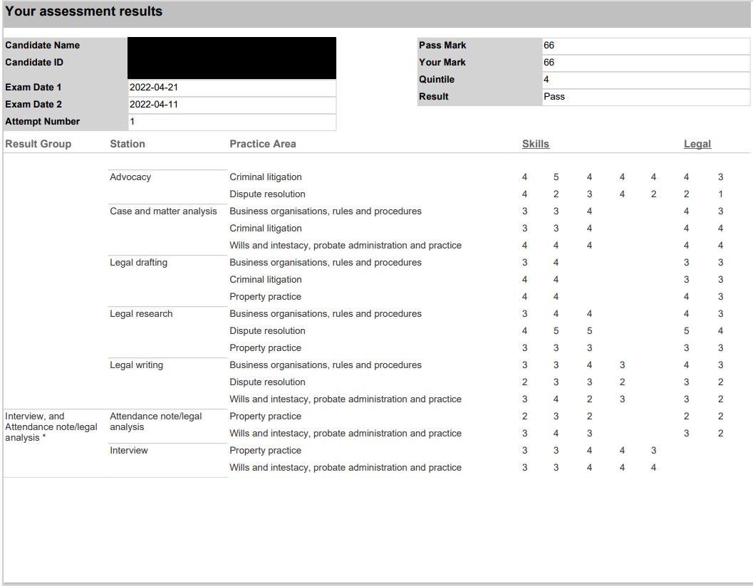
SQE2 marks explained

Slide 19
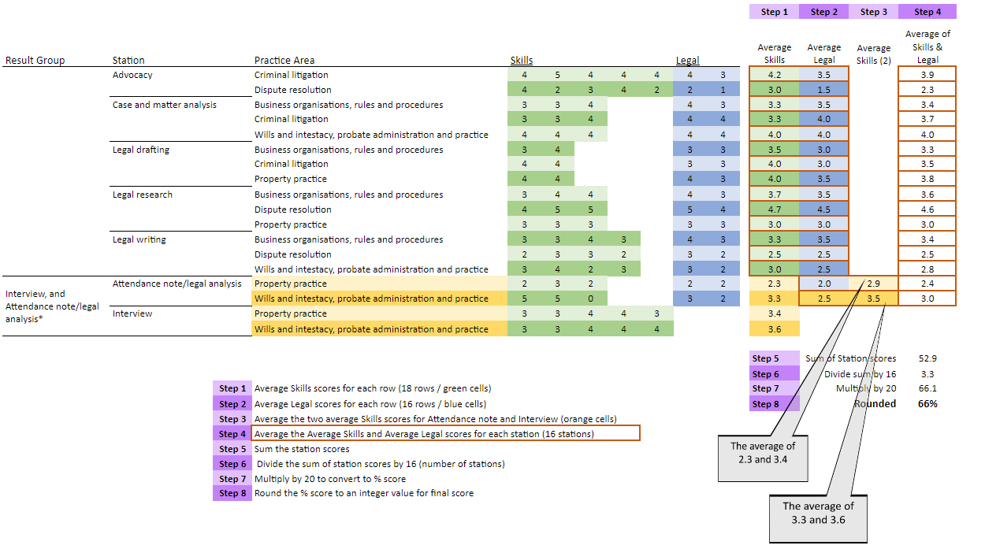
SQE2 marks

Slide 20
SQE key dates
Upcoming assessments
  October 2022 - second sitting of SQE2
  January 2023 - third sitting of SQE1
  From April 2023 - SQE2 assessments every quarter
Other elements
  EDI candidate survey questions update - before the end of 2022
  Q1 2023 - FLK annual review process
  Spring 2023 - SQE annual report published

Slide 21




Keep in touch
Send your queries to contactcentre@sra.org.uk
Join our SQE LinkedIn group
SQE assessment sqe.sra.org.uk / SQE route sra.org.uk/sqe
SQE Update bulletin sra.org.uk/sqeupdate

