Slide 1
SQE: scaled scoring and SQE1 results
Julie Swan, Director of Education and Training, SRA (Chair)
Yiannis Chrysanthou, Head of Stakeholder Engagement, Kaplan
Lisa Coombes, Director of Psychometrics and Assessment Development, Kaplan

Slide 2
Why use scaled scores?
Common standard across papers and assessment windows provides more flexibility for candidates
Provides standardised scoring, making interpretation easier
Scaled scores are widely used, and provide consistency
It means all our assessments will be directly comparable
Scaled scoring only changes the way we view results

Slide 3
Score scaling - overview
Carry out standard setting, establish a pass mark
Set the pass mark to equal 300
Calculate the relationship between raw score and scale scores between 0 and 300
Do the same for scores between 300 and 500
Convert candidate scores to a scale score
Repeat for each distinct paper in an assessment window
Award all candidates a pass/fail based on their scale score

Slide 4
Score scaling – Step 1
Carry out standard setting, establish a pass mark
This establishes the passing standard for each paper
Follows well established standard setting methods to provide a pass mark for each paper
This pass mark is used throughout the process, but will always be set to 300 on our scaled score

Slide 5
Score scaling – Step 2
Set the pass mark to equal 300
In this example the pass mark is set at 100 correct answers out of a maximum of 180

Slide 6
Score scaling – Step 3
A line is drawn showing the relationship between raw scores and scale scores between 0 and the pass mark

Slide 7
Score scaling – Step 4
Another line is drawn to show the relationship between raw scores and scale scores between 300 and 500

Slide 8
Score scaling – Step 5
Convert candidate scores to a scale score
In this example
  80 = 240
  100 = 300 (pass mark)
  120 = 350

Slide 9
Score Scaling – Step 6
Repeat for each distinct paper in an assessment window
In this example there are two sets of scaling
  Green has a pass mark of 90
  Blue has a pass mark of 110
  Both scale to 300 as indicated by the circle
Scaling is different for every paper, but the scale pass mark is always 300 and scores are adjusted either side of this

Slide 10
Score scaling – Step 7
Award all candidates a pass/fail based on their scale score
Anyone with 300 or more will pass the assessment

Slide 11
Summary
Score scaling provides a standardised way of describing and comparing multiple papers
Underlying processes remain the same
  Standards are set as usual
  Psychometric analysis provides the same comprehensive test validation
Only the final scores are converted to provide direct comparability between papers and deliveries
Because the outcomes relate to the pass mark, outcomes are the same for both raw score and scale score pass marks

Slide 12
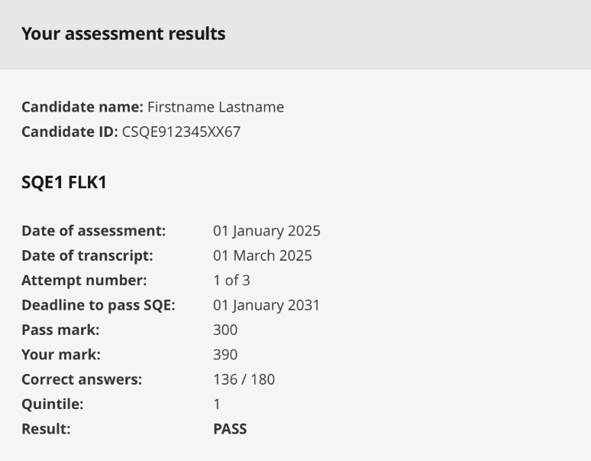
FLK1 Results page
Core information
Deadline to pass SQE
Overall result
Robert/via Flickr: Jemimus

Slide 13
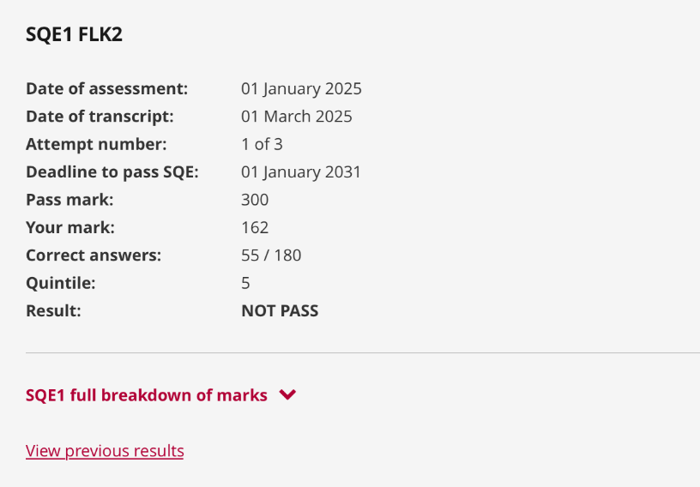
FLK2 Results page
Core information
Overall result
Previous results
Full breakdown
Robert/via Flickr: Jemimus

Slide 14
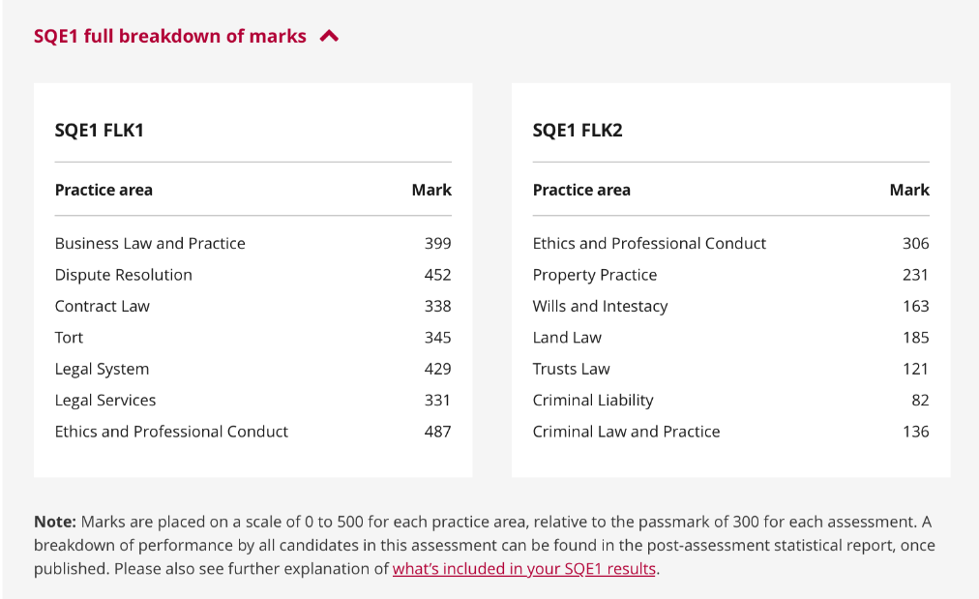
Using the full breakdown
By practice area
Full breakdown
Further information
Robert/via Flickr: Jemimus

